Slide 1
CROSSWORD PUZZLE GAME
GROUP MEMBERS:
MUHAMMAD ANAS HASSAN 20K-1726
MUHAMMAD WARZAN 20K-1649

Slide 2
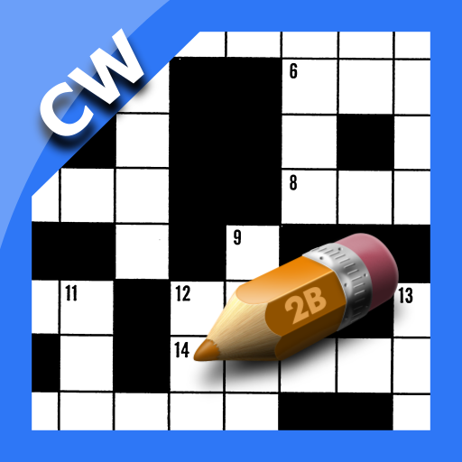
INTRODUCTION
The Crossword puzzle is a game in which we have to find and mark all the hidden words inside the grid. The words may be placed horizontally, vertically, or diagonally. Crossword Puzzle Game has a commonplace in newspapers and magazines.

Slide 3
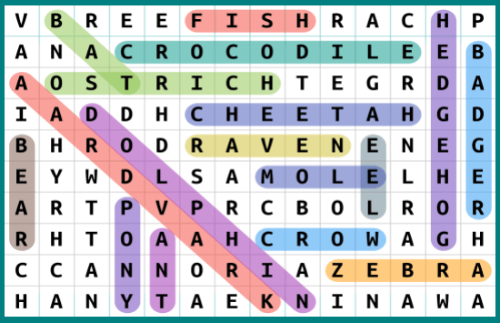
HOW TO PLAY THIS GAME
The purpose is to locate a list of words hidden on a grid in all direction i.e horizontally, vertically and as well as diagonally.
If find marked that words simply.
Words should be names, places, animals and things etc.

Slide 4





BENEFITS OF THIS GAME
SOME BENEFITS ARE
Expand Vocabulary
Improves memory and brain functions
Enhance problem solving skills
Stress relief
Sense of accomplishment
So, why not give it a chance and reap the benefits of crossword puzzles while having fun? Sounds interesting, doesn’t it?

Slide 5
FEATURES OF THIS GAME
SOME FEATURES ARE
It contains 5 lives for the user. It is user friendly.
User have the right to change the font and the background colour in the settings menu.
User can see his/her score and lives at every level.
It contains 3 different levels with different difficulty level.
If user enter correct word, score is increemented while lives are decremented in case if the user enter wrong word that is not included in the puzzle.
If the lives are finished means the user entered wrong word 5 times that are not included in the grid, the then the program displays “GAMEOVER” because one wrong word means one life is wasted or finished.
It contains instruction label (option) at the start of the UI, which helps user to understand the instructions before playing the game.

Slide 6
PROCEDURES IN THE PROGRAM

Slide 7
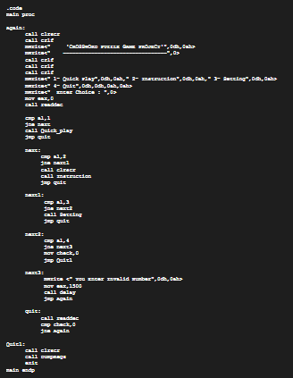
PROCEDURES:
Quick_play PROC
Instruction PROC
Setting PROC
ChangeFontColor PROC
ChangeBackgroundColor PROC
ChangeBothFontAndBackgroundColor PROC
Level1 PROC
Level2 PROC
Level3 PROC
Read_File PROC

Slide 8
SOME SNAPSHOTS OF CROSSWORD PUZZLE GAME

Slide 9
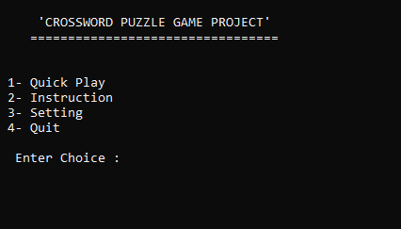
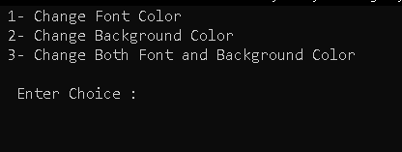
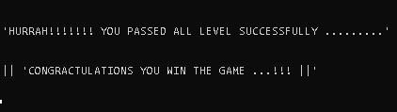
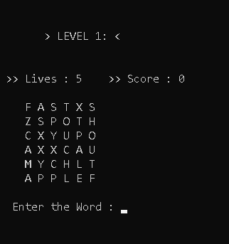
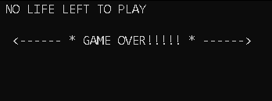
GAMEOVER
START UI
LEVEL 1
SETTINGS
WINNER

Slide 10
THANKS FOR YOUR TIME

